Slide 1
MGMT 6055 Project Scope & requirements
Lawrence Kinlin School of Business
Module 3
Notes:
Content for slides in this PPT file is drawn significantly from PMBOK, 6th edition, published by PMI (required text for this course)

Slide 2
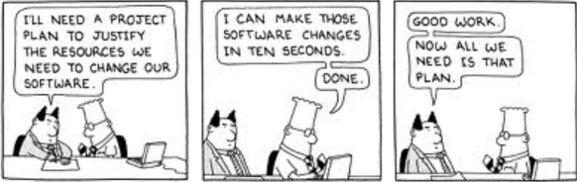
Learning Objectives
Review from last module:
Putting a Project Idea on Paper: Statement of Work
Authorizing the Project to Begin: Project Charter
Project Life Cycles, Triple Constraints
Develop Project Management Plan
Scope Management Knowledge Area
Plan Scope Management:
RACI charts
Notes:
Image Source: https://www.google.com/url?sa=i&rct=j&q=&esrc=s&source=images&cd=&cad=rja&uact=8&ved=2ahUKEwiM8cerhrbaAhXr54MKHX1qAM0QjRx6BAgAEAU&url=http%3A%2F%2Fpm4web.blogspot.com%2F2010%2F11%2F10-tips-for-keeping-momentum-on-web.html&psig=AOvVaw2RpULQXOSFAvWjnDGEa1Uc&ust=1523667462394880

Slide 3
Statement of Work (SOW)
A narrative description of the work to be completed
Comes from senior management or the project sponsor
One or two page document
From last module…

Slide 4
The Project Charter
From last module…
A document that formally authorizes a project (or phase)
It establishes a partnership between the performing organization and requesting organization (external: customer)
Formally initiates the project
Assign a Project Manager

Slide 5
REMINDER TO STUDENTS!
From last module…
IMPORTANT!
For the mid-term and final exams in this course:
You will NOT need to memorize every input, tool & technique, and output (ITTO) for the processes we learn in each module.
But!
You WILL need to memorize some ITTOs for the exams - they will be highlighted in BLUE FONT in the PowerPoint slides.
If an ITTO is NOT highlighted in BLUE FONT in the course PowerPoint slides, then you are NOT required to memorize it when studying for the mid-term or final exam.

Slide 6
Careful planning is required so that project objectives will be met The Project Manager is responsible for planning

Slide 7
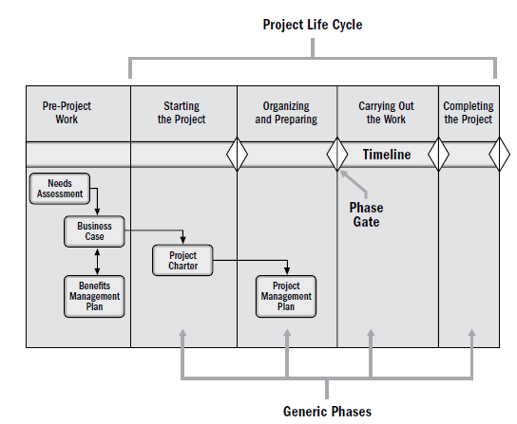
Project life cycle
Note that some documents are prepared before the project starts. We will learn about many more project documents in this course and in the program…
Figure 1-8 from PMBOK 6th ed. (p. 30)
Notes:
Can measure performance against scope statement
Let everyone know what you’re doing and they can agree

Slide 8

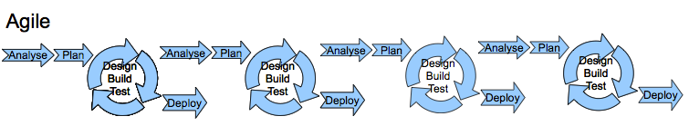
Waterfall vs. Agile project life cycles
Waterfall projects: Also known as traditional or predictive projects
- Generally sequential
- Project activities are planned at the start and executed as the project progresses
Agile (or adaptive, or iterative) projects use a different methodology, with successive planning/execution cycles (you will learn about agile PM later in the PRJ program)
Notes:
Source: savaged.wordpress.com
Note: PMBOK 6th edition describes additional categories of project life cycles (see assigned readings)

Slide 9
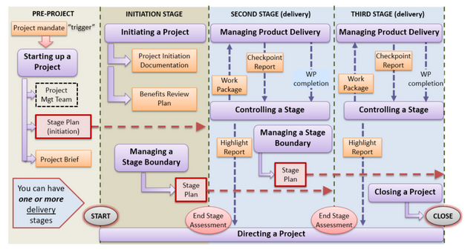
Prince2 (Project Management methodology seen in the UK and Europe)
(See Slide Notes)
Notes:
Note: Students are not required to study/memorize this diagram. However, they ARE expected to know that PRINCE2 is conceptually different from PMBOK (see videos on next slide). Also, PMBOK is familiar to project managers around the world; PRINCE2 is relatively less common in North America but is more familiar to project managers in the UK and Europe. The first video on the next slide summarizes some key differences between PMBOK and PRINCE2.
Source: https://www.google.ca/url?sa=i&rct=j&q=&esrc=s&source=images&cd=&cad=rja&uact=8&ved=2ahUKEwirsvyN27XaAhUL2IMKHX2VBbAQjRx6BAgAEAU&url=http%3A%2F%2Fwww.davelitten.com%2Fprince2-2017-small-projects%2F&psig=AOvVaw3jn8hHf8fotYfdFdSg2c5p&ust=1523655915495914

Slide 10
FYI…
If you’re curious about learning the differences between Prince2 and PMBOK, check out these videos!
https://www.youtube.com/watch?v=N67bCigkf_M (4 minutes)
https://www.youtube.com/watch?v=57BpgxZh7FQ (10 minutes)
If you want to learn more about the PMBOK 7th edition (and how it is different from the 6th edition), check out these links! PMI – PMBOK 7th edition Frequently Asked Questions (FAQ)
PMI – Comparing 6th and 7th editions of PMBOK (summary graphic)

Slide 11

The Triple Constraints
FYI: Check out this YouTube video for an Explanation of the Triple Constraints triangle. It’s a fundamental concept in project management...
Scope, cost, schedule are different elements of project management, but they are interrelated

Slide 12
Introduction to the Project Management Plan (“The Master Plan”)
Formal, approved document that defines how the project is executed, monitored and controlled.
May be detailed (for smaller projects) or a summary plan with subsidiary plans (for larger projects)
Part of the Project Integration Management knowledge area in PMBOK (not Scope Management) because it applies to more than scope-related processes

Slide 13
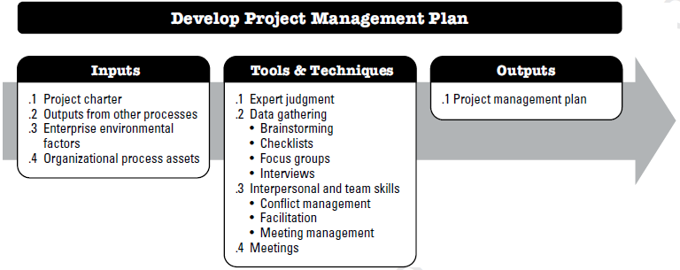
Develop Project Management Plan
Notes:
Source: PMBOK 6th edition (PMI) – Figure 4-4, p. 82

Slide 14
What types of components would you see in a project management plan?
Risk management plan
Change management plan
Procurement management plan
Scope management plan
Cost management plan
Scope management plan
Life cycle description
Requirements management plan
Quality management plan
Baselines
Etc….
Notes:
Source: PMBOK 6th edition (PMI) – p. 89

Slide 15
Project Management Plan – Sample for small project
(FYI)

Slide 16
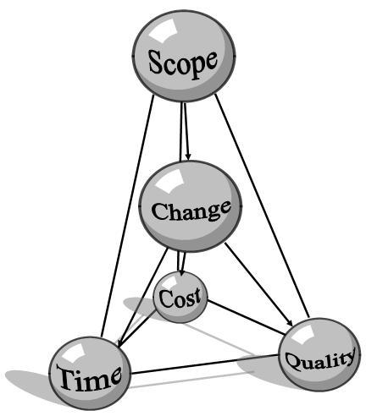
Lets talk about Scope Management

Slide 17
What is Scope and SCOPE MANAGEMENT?
The scope of a project tells you what it is you are creating or building, what it is you are trying to accomplish.
Scope Management is the set of project management processes (a “knowledge area”) concerned with determining and managing what is and what is not included in the project and product.

Slide 18
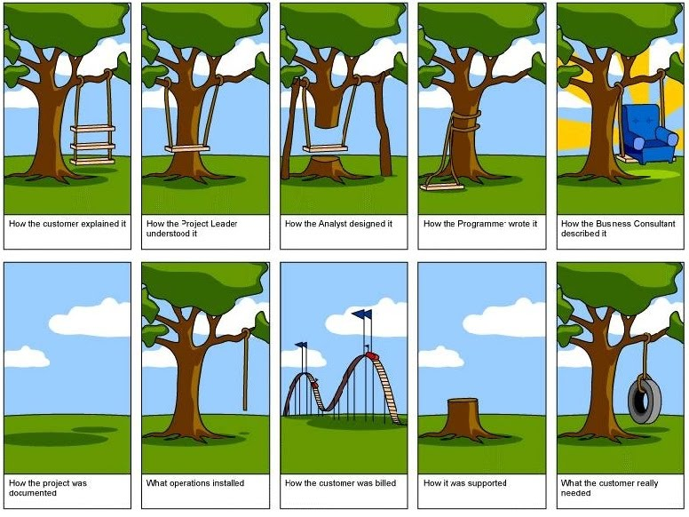

Slide 28
THIS IS WHY PROJECT SCOPE NEEDS TO BE MANAGED (every stakeholder must have a shared and precise understanding of what will be produced by the end of the project)
Notes:
Source: www.agile-scrum-master-training.com

Slide 29
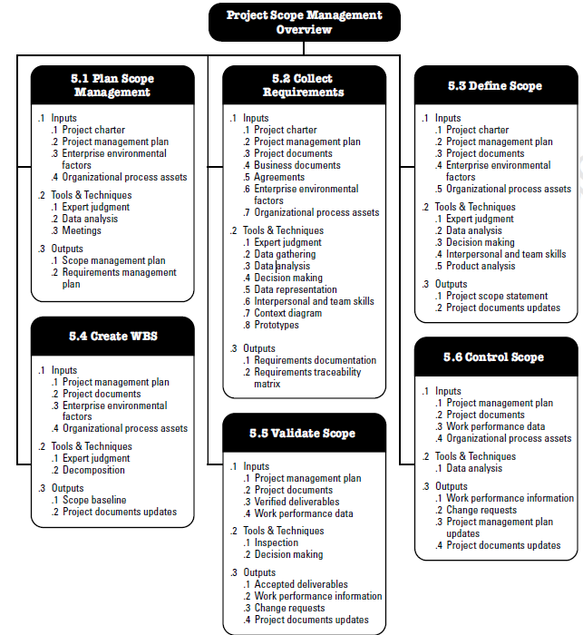
SIX scope-related processes (activities) are described in the PMBOK 6th ed. text
Source: PMBOK (6th ed), pg. 130

Slide 30
Six Scope Processes
Plan Scope Management – How is scope going to be managed for the project?
Collect Requirements – Defining and documenting stakeholder (including client) needs, to meet the project objective
Define Scope - Produce a document (a “Scope Statement”) which is the master blueprint for the project and product
Create Work Breakdown Structure (WBS) – Produce a detailed breakdown of work elements for the project
Validate Scope – Obtain the approval from the client for the deliverables that are produced [Note: In the 4th edition of PMBOK, this process is called ‘Verify Scope’]
Control Scope – Compare actual results to planned results (and investigate/correct variations)
Notes:
Collecting rqmt: defining and documenting stakeholder needs to meet the project objective
Define scope: develop a detailed description of the project and product

Slide 31
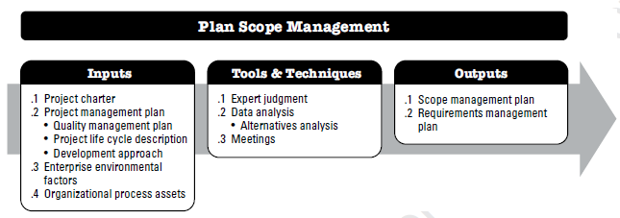
Planning Scope Management

Slide 32
Output: Scope Management Plan
Describes how the scope will be defined, developed, monitored, controlled, and verified
How will the detailed scope statement be prepared? When will it be created? With what resources? Who will participate in its creation and who will approve it?
How will the Work Breakdown structure be prepared? When will it be created? With what resources? Who will participate in its creation and who will approve it?
How will deliverables be accepted? Who determines acceptance criteria? How do we contact them? When will acceptance happen?
How will requests for changes to scope be handled? Are there forms or procedures that we need to adopt? Who is allowed to approve changes? Are there guidelines or timelines for the process?
Roles and responsibilities of project team members and relevant stakeholders

Slide 33
Output: Requirements Management Plan
Describes how the requirements will be identified, analyzed, documented, and managed. will be defined, developed, monitored, controlled, and verified
How will requirements activities be planned, tracked through the project life cycle, and reported?
Who will be involved in each of these tasks?
How are priorities to be determined?
Roles and Responsibilities

Slide 34
Roles and Responsibilities
Can be organized into RACI Chart - Responsible, Accountable, Consult, Inform
Understand how these charts are designed AND how they can be used to identify potential problems (see videos next slide)

Slide 35
RACI Charts
5-minute Youtube video about RACI charts…
https://www.youtube.com/watch?v=1U2gngDxFkc
3-minute Youtube video about RACI charts…
https://www.youtube.com/watch?v=MhowzlmvhlI

Slide 36


Document flow
Project Charter (the document that formally authorizes and initiates the project)
Management Plan(s)
SOW (the idea for the project – completed before the project starts)
“PROGRESSIVE ELABORATION” (more detail about the project is added as
we proceed from one document to the next)

